Slide 1




Multidimensional Arrays
Using Array of Arrays, Matrices and Cubes
Advanced Java
SoftUni Team
Technical Trainers
Software University
http://softuni.bg

Slide 2


Table of Contents
Array Overview
Matrices and Multidimensional Arrays
Jagged Arrays

Slide 3
Have a Question?
sli.do ##JavaAdvanced

Slide 4
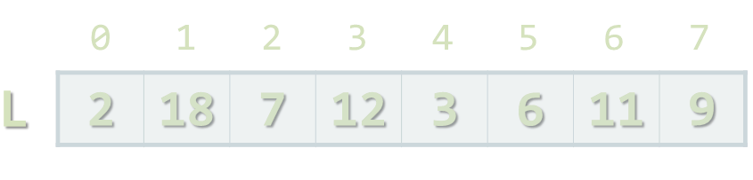
Arrays

Slide 5
Arrays
In programming array is a sequence of elements
All elements are of the same type
Has fixed size (length)
Element index
0 1 2 3 4
Array of 5 elements
… | … | … | … | …
Element of an array

Slide 6
Working with Arrays in Java
Allocating an array of 10 integers:
Assigning values to the array elements:
Accessing array elements by index:
int[] numbers = new int[10];
for (int i=0; i < numbers.length; i++)
numbers[i] = i+1;
numbers[3] = 20;
numbers[5] = numbers[2] + numbers[7];

Slide 7
Arrays of Strings
You may define an array of any type, e.g. String:
String[] names = { "Peter", "Maria", "Katya", "Todor" };
for (int i = 0; i < names.length; i++) {
System.out.printf("names[%d] = %s\n", i, names[i]);
}
for (String name : names) {
System.out.println(name);
}
names[4] = “Izdislav"; // ArrayIndexOutOfBoundsException
names.length = 5; // array.length is read-only field

Slide 8
Problem: Read, Sort and Print Array
Write a program that:
Read array of strings from the console
Sort array alphabetically
Print new array to console
String[] names = { "Peter", "Maria", "Katya", "Todor" };
String[] names = { "Katya", "Maria", "Peter", "Todor" };

Slide 9
Solution: Read, Sort and Print Array
Scanner scanner = new Scanner(System.in);
int n = scanner.nextInt();
String[] lines = new String[n];
for (int i = 0; i <= n; i++) {
lines[i] = scanner.nextLine();
}
Arrays.sort(lines);
for (int i = 0; i < lines.length; i++) {
System.out.println(lines[i]);
}
Check your solution here: https://judge.softuni.bg/Contests/Practice/Index/381#0

Slide 10
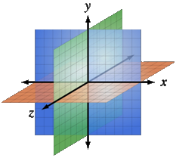
Multidimensional Arrays
Using Array of Arrays, Matrices
and Cubes

Slide 11
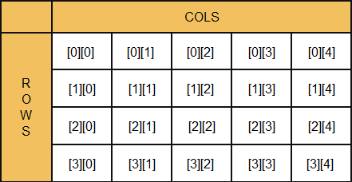
What is Multidimensional Array?
Array is a systematic arrangement of similar objects
Multidimensional arrays have more than one dimension
The most used multidimensional arrays are the 2-dimensional
Row Index
Col Index

Slide 12
Declaring and Creating Multidimensional Arrays
Declaring multidimensional arrays:
Creating a multidimensional array
Use new keyword
Must specify the size of each dimension
int[][] intMatrix;
float[][] floatMatrix;
String[][][] strCube;
int[][] intMatrix = new int[3][4];
float[][] floatMatrix = new float[8][2];
String[][][] stringCube = new String[5][5][5];

Slide 13
Initializing Multidimensional Arrays
Initializing with values multidimensional array:
Matrices are represented by a list of rows
Rows consist of list of values
int[][] matrix = {
{1, 2, 3, 4}, // row 0 values
{5, 6, 7, 8} // row 1 values
};

Slide 14
Accessing Elements
Accessing N-dimensional array element:
Getting element value example:
Setting element value example:
nDimensionalArray[index₁] … [index_{n}]
 | 0 | 1
0 | 1 | 2
1 | 3 | 4
int[][] array = {{1, 2}, {3, 4}}
int element₁₁ = array[1][1]; // element₁₁ = 4
int[][] array = new int[3][4];
for (int row = 0; row < array.length; row++)
for (int col = 0; col < array[0].length; col++)
array[row][col] = row + col;

Slide 15
Reading a Matrix – Example
public static void main(String[] args) {
Scanner scanner = new Scanner(System.in);
int rows = Integer.parseInt(scanner.nextLine());
int cols = Integer.parseInt(scanner.nextLine());
int[][] matrix = new int[rows][cols];
for (int row = 0; row < rows; row++) {
for (int column = 0; column < cols; column++) {
System.out.println(
String.format("matrix[%1$d][%2$d] = ", row, column));
String inputNumber = scanner.nextLine();
matrix[row][column] = Integer.parseInt(inputNumber);
}
}
}

Slide 16
Problem: Sum of All Elements of Matrix
Read matrix from the console
Print number of rows
Print number of columns
Print the sum of given array
int[][] matrix = {
{ 5, 2, 3, 1 },
{ 1, 9, 2, 4 },
{ 9, 8, 6, 11 }
};

Slide 17
Solution: Sum of All elements of Matrix
public static void main(String[] args) {
int[][] matrix = new int[4][4];
System.out.println(matrix.length);
System.out.println(matrix[0].length);
for (int row = 0; row < matrix.length; row++) {
for (int col = 0; col < matrix[row].length; col++) {
System.out.print(matrix[row][col] + " ");
}
System.out.println();
}
}
Gets length of 0th dimension (rows)
Gets length of 1st dimension (columns)
Check your solution here: https://judge.softuni.bg/Contests/Practice/Index/381#0

Slide 18
Problem: Find Specific Square in Matrix
Find 2x2 square with max sum in given matrix
Read matrix from the console
Find biggest sum of 2x2 submatrix
Print result like new matrix
int[][] matrix = {
{7, 1, 3, 3, 2, 1},
{1, 3, 9, 8, 5, 6},
{4, 6, 7, 9, 1, 0} };
9, 8
7, 9

Slide 19
Solution: Find Specific Square in Matrix
Finding maximal sum of 2x2 submatrix
int bestSum = Integer.MIN_VALUE;
int resultRow;
int resultCol;
for (int row = 0; row < matrix.length - 1; row++)
for (int col = 0; col < matrix[row].length - 1; col++)
int sum = matrix[row][col] + matrix[row][col + 1] + matrix[row + 1][col] + matrix[row + 1][col + 1];
if (sum > bestSum)
bestSum = sum;
resultRow = row;
resultCol = col;
Check your solution here: https://judge.softuni.bg/Contests/Practice/Index/381#0

Slide 20

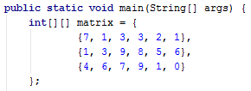
Practice: Using Multidimensional Arrays
Live Exercises in Class (Lab)

Slide 21

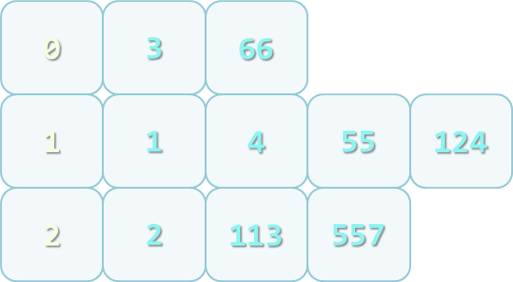
Jagged Arrays
What are Jagged Arrays and How to Use Them

Slide 22
Jagged Arrays
Jagged arrays are multidimensional arrays
But each dimension has different size
A jagged array is an array of arrays
Each of the arrays has different length
 | 0 | 1 | 2 | 3
0 | 7 | 3 | 4 | 2
1 | 5 | 1
2 | 9 | 3 | 1
int[][] jagged = new int[3][];
jagged[0] = new int[4];
jagged[1] = new int[2];
jagged[2] = new int[3];

Slide 23
Filling a Jagged Array
public static void main(String[] args) {
Scanner scanner = new Scanner(System.in);
int[][] jagged = new int[5][];
for (int i = 0; i < jagged.length; i++) {
String[] inputNumbers = scanner.nextLine().split(" ");
jagged[i] = new int[inputNumbers.length];
for (int j = 0; j < jagged[i].length; j++) {
jagged[i][j] = Integer.parseInt(inputNumbers[j]);
}
}
}

Slide 24
Problem: Group Numbers
Read a set of numbers and group them by their remainder when dividing to 3 (0, 1 and 2)
1, 4, 113, 55, 3, 1, 2, 66, 557, 124, 2

Slide 25
Solution: Group Numbers
int[] numbers = { 1, 4, 113, 55, 3, 1, 2, 66, 557, 124, 2 };
int[] sizes = new int[3];
int[] offsets = new int[3];
for (int number : numbers)
int reminder = number % 3;
sizes[reminder]++;
int[][] numbersByRemainder =
{ new int[sizes[0]], new int[sizes[1]], new int[sizes[2]] };
for (int number : numbers)
int reminder = number % 3;
int index = offsets[remainder];
numbersByRemainder[remainder][index] = number;
offsets[remainder]++;
Check your solution here: https://judge.softuni.bg/Contests/Practice/Index/381#0

Slide 26
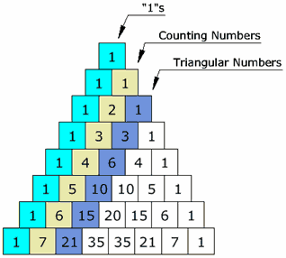
Problem: Pascal Triangle
Write a program which print on console Pascal Triangle

Slide 27
Solution: Pascal Triangle
int[][] pascalTriangle = new int[height][];
int currentWidth = 1;
for (int currentHeight = 0; currentHeight < height; currentHeight++)
pascalTriangle[currentHeight] = new int[currentWidth];
int[] currentRow = pascalTriangle[currentHeight];
currentWidth++;
currentRow[0] = 1;
currentRow[currentRow.length - 1] = 1;
if (currentRow.length > 2)
for (int i = 1; i < currentRow.length - 1; i++)
int[] previousRow = pascalTriangle[currentHeight - 1];
int previousRowSum = previousRow[i] + previousRow[i - 1];
currentRow[i] = previousRowSum;
Check your solution here: https://judge.softuni.bg/Contests/Practice/Index/381#0

Slide 28
Nested Lists
Nested lists can be used for representation of jagged array
Can be initialized only main list which contains another lists
You can initialize everything at once
Initialized with capacity will initialize capacity for main List, but not for the nested lists
ArrayList<ArrayList> listOLists = new ArrayList<ArrayList>();
ArrayList<ArrayList<String>> listOLists =
new ArrayList<ArrayList<String>>();
ArrayList<ArrayList<String>> listOLists =
new ArrayList<ArrayList<String>>();

Slide 29
Practice: Jagged Arrays Manipulations
Live Exercises in Class (Lab)

Slide 30

Summary
Multidimensional arrays have more
than one dimension
Two-dimensional arrays are like tables
with rows and columns
Jagged arrays are arrays of arrays –
each element is an array itself

Slide 31









Java Syntax
https://softuni.bg/courses/java-fundamentals

Slide 32

License
This course (slides, examples, demos, videos, homework, etc.) is licensed under the "Creative Commons Attribution-NonCommercial-ShareAlike 4.0 International" license
Attribution: this work may contain portions from
"Fundamentals of Computer Programming with Java" book by Svetlin Nakov & Co. under CC-BY-SA license

Slide 33






Free Trainings @ Software University
Software University Foundation – softuni.org
Software University – High-Quality Education, Profession and Job for Software Developers
softuni.bg
Software University @ Facebook
facebook.com/SoftwareUniversity
Software University @ YouTube
youtube.com/SoftwareUniversity
Software University Forums – forum.softuni.bg

